Slide 1
LEGUMAN
Taking market gardening to the next level

Slide 2
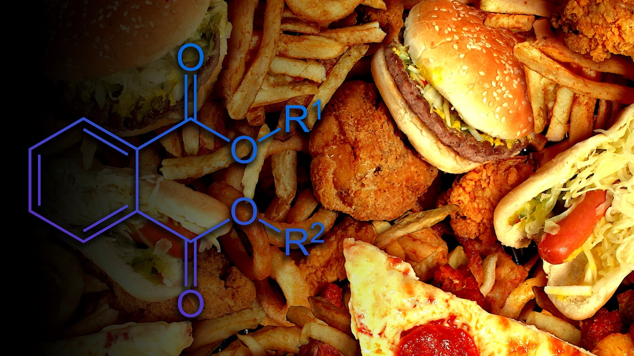
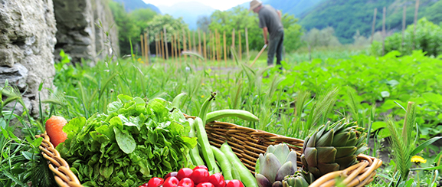
Too much
junk food
Taking the matter into his own hands

Slide 3
The plan
Bring him online
Make him visible to city people
Offer deliveries
Offer card or cash payment

Slide 4
My job
Mobile first
Organic colours
Optimization
SEO

